Slide 1
Microgravity Astronaut Game
Made For Astronauts Training

Slide 2
Objectives
Addressing astronaut challenges in microgravity
Offers zero-gravity experience for fun and health
Space-based fun and relaxation.
Boosting resilience in space

Slide 3
Core Features
Zero-Gravity Mechanics
Collectible Mechanic
Winning and Losing Conditions
Zero-gravity gameplay with slow movement and inertia.
Collect 10 space items in a constantly changing environment.
Win by collecting all 10 items within the time limit. Lose if time runs out before collecting all 10 items.
01
02
03
04
05
Astronaut Avatar
Timed Gameplay
Navigate the game world using keyboard keys and zero-gravity mechanics.
Strategic movement required to beat the 30-second countdown.

Slide 4
TECHNOLOGIES USED
M
Matter.js
For zero-gravity movement, Matter.js provides realistic physics simulation, allowing smooth, floating movement for the player avatar.
React
R
The game is built using React for frontend functionality and structure.
A
Asset Management
The game incorporates images and assets like an astronaut sprite, collectible items, and a space-themed background.
Phaser.js
P
A popular 2D game framework used to implement physics and interactive game elements, such as the astronaut and collectibles.

Slide 5

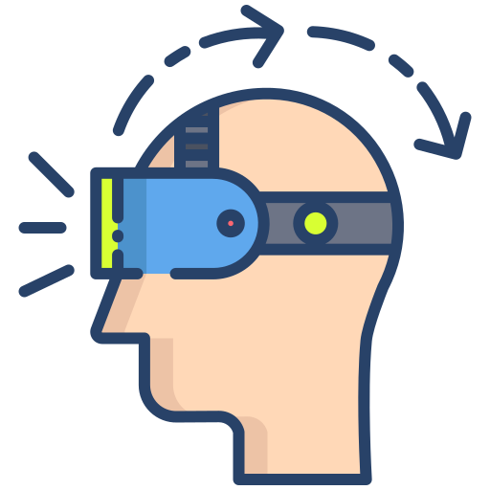
FUTURE IMPROVEMENTS
Multiplayer Mode
Augmented Reality
Adding multiplayer support could encourage team-building exercises among crew members.
Future versions could explore immersive AR experiences that would use an astronaut’s actual surroundings on the space station.

Slide 6
